Slide 1
Nutrition is a revenue and not a cost
Optimizing the Nutrition Care Pathway by Digitalization
Dim3 Investor Deck

Slide 2







Transforming the management of clinical nutrition
Dim3 is establishing a data continuum between hospitals, nursing homes and homecare so that nutrition quality of care is optimized throughout the entire patient journey
PATIENT JOURNEY
Notes:
Animation?

Slide 3

SECTION 01
Unmet Clinical Need

Slide 4



Malnutrition prevalence in Belgium
WHO: “Malnutrition refers to deficiencies, excesses, or imbalances in a person’s intake of energy and/or nutrients.”
51% at risk
33% malnourished
57% at risk
16% malnourished
49% at risk
12,8% malnourished
References:
https://www.who.int/news-room/fact-sheets/detail/malnutrition
https://kce.fgov.be/en/organization-and-reimbursement-of-enteral-and-parenteral-nutrition-in-and-outside-the-hospital-in

Slide 5

Malnutrition is Costly
59%
INCREASED LOS¹
DAYS
UNTREATED MALNUTRITION COSTS
DAYS
€170B
per year in EU²
INCREASED LENGTH OF STAY (LOS)
INCREASED HEALTHCARE COSTS
1. https://clinicalnutritionespen.com/article/S2405-4577(15)00097-2/pdf
2. https://www.nature.com/articles/ejcn2014280

Slide 6





Root Causes of Malnutrition
Poor Detection
Less than 60% Compliance^{1,2}
Patients at malnutrition risk are not detected or not detected soon enough
Patients don’t receive what they have been prescribed. Very few know the issue
Lack of Knowledge
Multi-step, Disconnected Care
Professionals lack knowledge and sometimes interest in nutrition, resulting in non-optimal practices
Multiple in-hospital transitions, lack of coordination between hospital and home and the trend toward shorter LOS intensifies an issue that is already ill-addressed
1. https://pubmed.ncbi.nlm.nih.gov/19572118/
2. https://pubmed.ncbi.nlm.nih.gov/31684024/

Slide 7
SECTION 02
Clinical Solution

Slide 8

Individualized Support Across the Continuum
Dim3 is establishing a data continuum between hospital, nursing homes and homecare to improve patient outcomes
360° Clinical Nutrition Management

Slide 9

Individualized Support Across the Continuum
By increasing compliance with better prescription and follow-up,
Dim3 solution has a direct impact on specialized food products sales
from hospital to home
Enteral / Food Complements / Adapted food Oncology – Sarcopenia - Pediatric …

Slide 10












ASSESS
The First
360° Clinical Nutrition Management System
Early nutrition risk screening
TREAT
FROM HOSPITAL→ HOME
Fast, clinically validated nutrition planning & monitoring
INFORM
Automated Medical Devices monitoring from hospital to home
Notes:
Dim3 offers expert tools that trigger, assess and sustain a cycle of nutritional well being, improving care, operational efficiencies and reducing costs

Slide 11
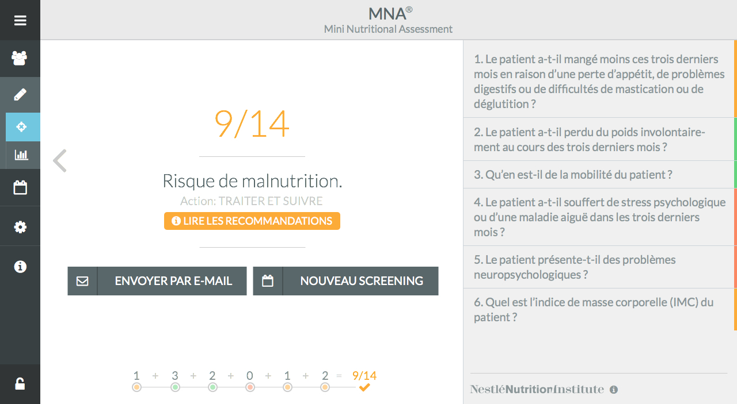
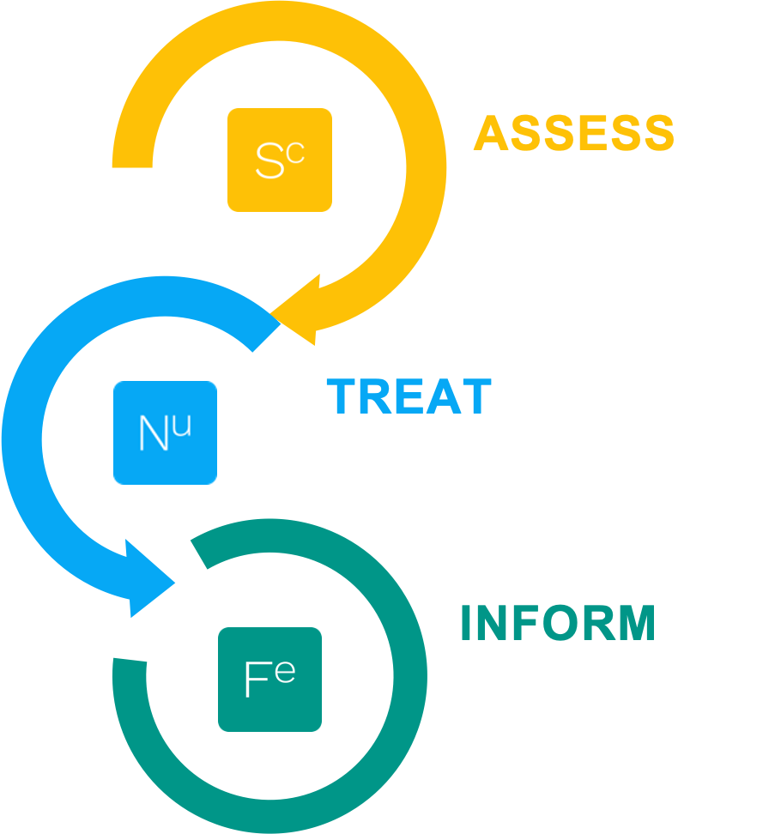

Slide 12
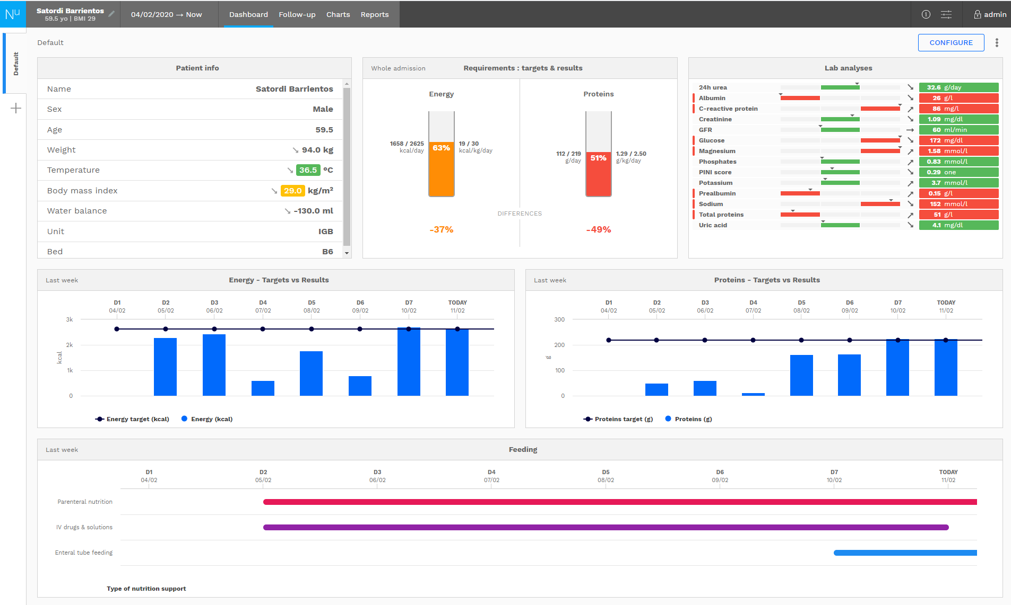

Slide 13
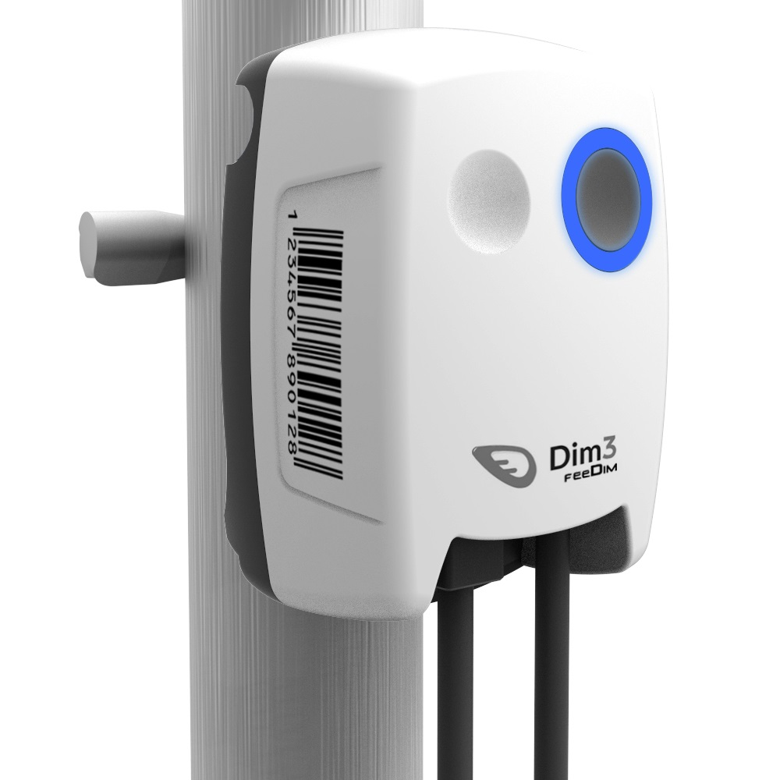

Slide 14







The Virtuous Cycle of Better Nutrition
KPI from Scientific Literature and Society Recommendations
BETTER COMPLIANCE
SAVE TIME
REDUCE COSTS
91%
68%
€3.300+
RX calories delivered to patients with computer-based decision support system¹
Less work time per patient with a nutrition management system²
Cost savings per malnourished patient on nutrition-focused program³
https://www.ncbi.nlm.nih.gov/pmc/articles/PMC3667982/
https://pubmed.ncbi.nlm.nih.gov/28975010/
https://www.clinicalnutritionjournal.com/article/S0261-5614(18)30201-2/fulltext

Slide 15



Benefits
Patients
Nutritional Team
Hospital
Homecare Provider
Optimize Tx compliance
Early prevention
Individualized care
Designed to improve outcomes:
  ↑Survival
  ↓ LOS
  ↓ Readmissions
  ↓ Admission to ICU
Optimize workflow & team communication
Centralize patient nutritional status
Reduce errors associated with manual data entry
Simulate optimal nutrition
Adopt clinical guidelines
Support scientific research with structured database
Evidence-based, 1st-class support
Recognized cost savings
Additional revenues by optimally documenting malnutrition
Stimulate interdisciplinary/ inter-hospital dialogue
Concrete building block for JCI/AC or other professional accreditation programs
Better service and support
Service differentiation
  Maximize compliance
  Accuracy of nutrition delivery
  Remote technical assistance
  Reduce unnecessary visits
  Efficient stock management

Slide 16
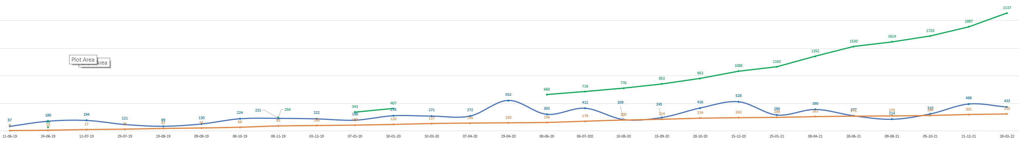
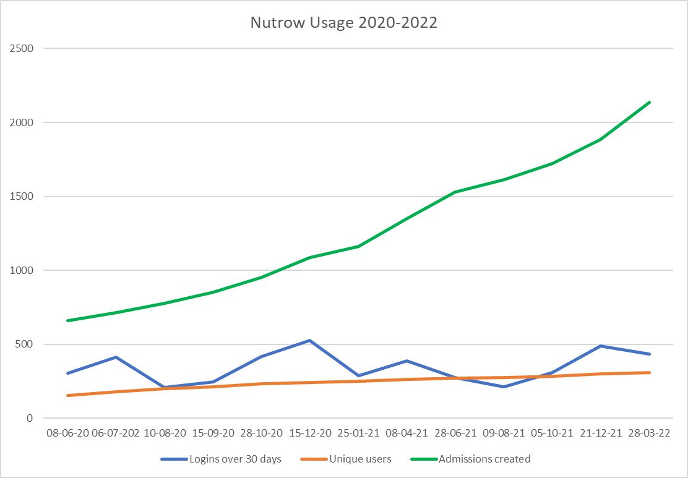
Nutrow usage evolution @USER 1 - ICU
2137
In Production
Jun 19
Admissions created
User logins over 30 days
Unique users
Mar 22
Confidential – Do not copy or distribute

Slide 17
Impact of Severity assessment
USING DIGITALIZATION TOOL OF DIM3 ENHANCE REIMBURSMENT & MARGIN
Analysis RCM ERASME
Source Mme Farine Coordinatrice nutritionnelle ERASME
Patients' w / malnutrition
31%
RCM reanalyzed
10 % of hospital stays
can gain in average
1 point of severity
if malnutrition is digitally detected and encoded.
Annual theoretical reimbursement gain
>500 k EUR / yr
Analysis RCM CHC Liège
Source Francoise Martin Coordinatrice nutritionnelle CHC
Patient records reanalyzed
60
Reimbursed days gain
43
Equivalent to an average 0.72 days / hospital stay
Analysis CHU Namur
Source Virginie Vanesse, Chef de service Alimentation Diététique
Patient reports reanalyzed
47
20 with severity increase
43% of stays
Fully revised report with lab data & malnutrition encoding generates a potential gain of
109 days on 47 dossiers
Equivalent to an average
2.3 days / hospital stay
Analysis VIVALIA Group : Hospital with geriatric ward Dr Lemaire RCM director
Patients with a RCM report indicating malnutrition
6%
Versus patients' w/ malnutrition detected by dietician
48%
Annual theoretical reimbursement gain
>350 k EUR / yr
Reimbursment by hospital stay + 1 day (average)
Confidential – Do not copy or distribute

Slide 18
SECTION 03
Market Overview & Opportunity

Slide 19

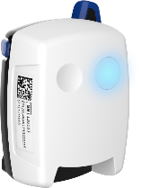
EU Initial Market Launch
5-COUNTRY COMMERCIAL FOCUS
BELGIUM | FRANCE | ITALY | GERMANY | NETHERLANDS
65 Y
ICU
Oncology
Wards with artificial feeding
Homecare Enteral
Homecare Parenteral
Homecare Oncology
Population:230 Million
Nutrition & Infusion pumps
Other Medical Devices

Slide 20
Large, Untreated Market with High Prevalence of Malnutrition
ANNUAL HOSPITALMARKET
€250M/y
1.75M Beds
EST. HOSPITAL & ICU BEDS IN DIM3 INITIAL 5 TARGET EU MARKETS^{1,2*}
2.2B
Homecare Days/y >65 years^{3*}
ANNUAL HOMECARE MARKET
€125M/y
INCLUDING 44M ENTERAL THERAPY DAYS FOR PATIENTS LEAVING THE HOSPITAL^{4*}
>50M Devices
INFUSION PUMP MEDICAL DEVICE | OEM MARKET
€116M
INITIAL SALES POTENTIAL BASED ON THE HOSPITAL ENTERAL AND INFUSION PUMP MARKET^{5,6}
* Belgium, France, Germany, Italy, Netherlands
https://ec.europa.eu/eurostat/statistics-explained/images/9/98/Hospital_beds_by_type_of_care%2C_2017_Health2019.png.
Rhodes, A., Ferdinande, P., Flaatten, H. et al. The variability of critical care bed numbers in Europe. Intensive Care Med 38, 1647–1653 (2012), https://link.springer.com/article/10.1007/s00134-012-2627-8
https://www.belgiqueenbonnesante.be/fr/hspa/domaines-de-soins-specifiques/soins-aux-personnes-agees
BCC Research - HLC071C - Infusion Pumps and Devices: Technologies and Global Markets – November 2016
https://www.grandviewresearch.com/industry-analysis/intravenous-infusion-pump-market
https://www.grandviewresearch.com/industry-analysis/internet-of-things-iot-healthcare-market
Notes:
References to be adapted

Slide 21


Clinical Partnerships & Market Traction
HOSPITAL & HOME CARE CONTRACTS*
Worldwide leader in clinical nutrition
€9.9B group turnover
European leader in homecare services
€900M group turnover
Global medical technology leader
€15B group turnover
*€180K to invoice
in the next 3 months
TECHNICAL PARTNERS | FEEDIM INTEGRATION
Pioneer in nutrition solutions
€25.3B group turnover
Leader in nutritional science
€126.5B group turnover
Global healthcare company
€35.5B group turnover
Global healthcare company
€85.5B group turnover
SCIENTIFIC COLLABORATIONS
Leading French university hospital
Leading German university hospital
Leading Dutch university hospital

Slide 22

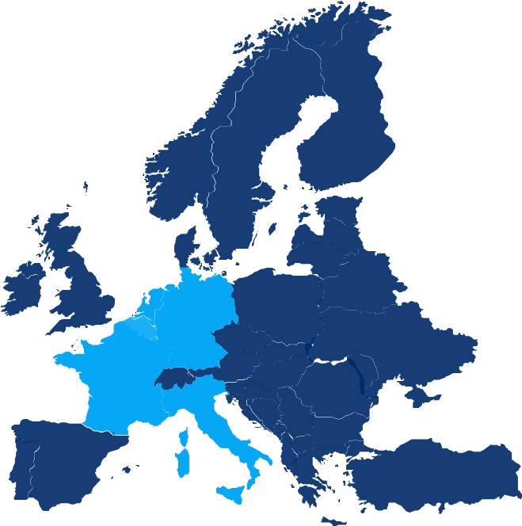
Go-to-Market Strategy
HOSPITAL
HOMECARE
MEDICAL DEVICES
Reference Hospitals group with internal clinical nutrition KOL
Leverage reference & sign distribution agreement(s) or B2B partnership(s)
Expand market coverage
Reference Enteral Nutrition Homecare Providers group, integrated with hospitals
Parenteral and per os Homecare
Expand market coverage
Prospect Medtech with spotted data transmission weaknesses
Proof of Concept contract
Feedim OEM contract

Slide 23
SECTION 04
€6M Funding –
Use of Proceeds

Slide 24
Use of Proceeds
Financing round: raising €6m to commercialize Dim3 digital health platform
USE OF PROCEEDS
5 EU countries commercial launch

Slide 25

Executive Summary
CLINICAL NEED
Dim3 SOLUTION
MARKET OPPORTUNITY
FUNDING
Malnutrition is a large medical problem associated with poor outcomes and increased costs.
Until now, there has been no nutritional support system that manages the entire patient journey from hospital to home.
Dim3 detects malnutrition risks sooner and provides the hardware and software to help doctors manage their patient’s needs in real time, from the hospital to the home.
Three B2B contracts currently signed with major players.
EU initial launch in 5 countries
Hospital Market
€250M/y
Homecare Market
€125M/y
Medical Device Market
€116M€
Belgium-based company seeking €6M in funding to speed up sales in EU and advance development of its CE-Marked nutrition management solution.
Notes:
You mention optimisation throughout the full journey - how do you think this will be realised (given the fact that the different actors in the journey typically work with plenty of different systems); how will integration work in reality?

Slide 26
THANK YOU
JEAN-CLAUDE HAVAUX
JC.HAVAUX@DIM3.COM
TELEPHONE: +32 475704830
www.dim3.com

